Slide 1
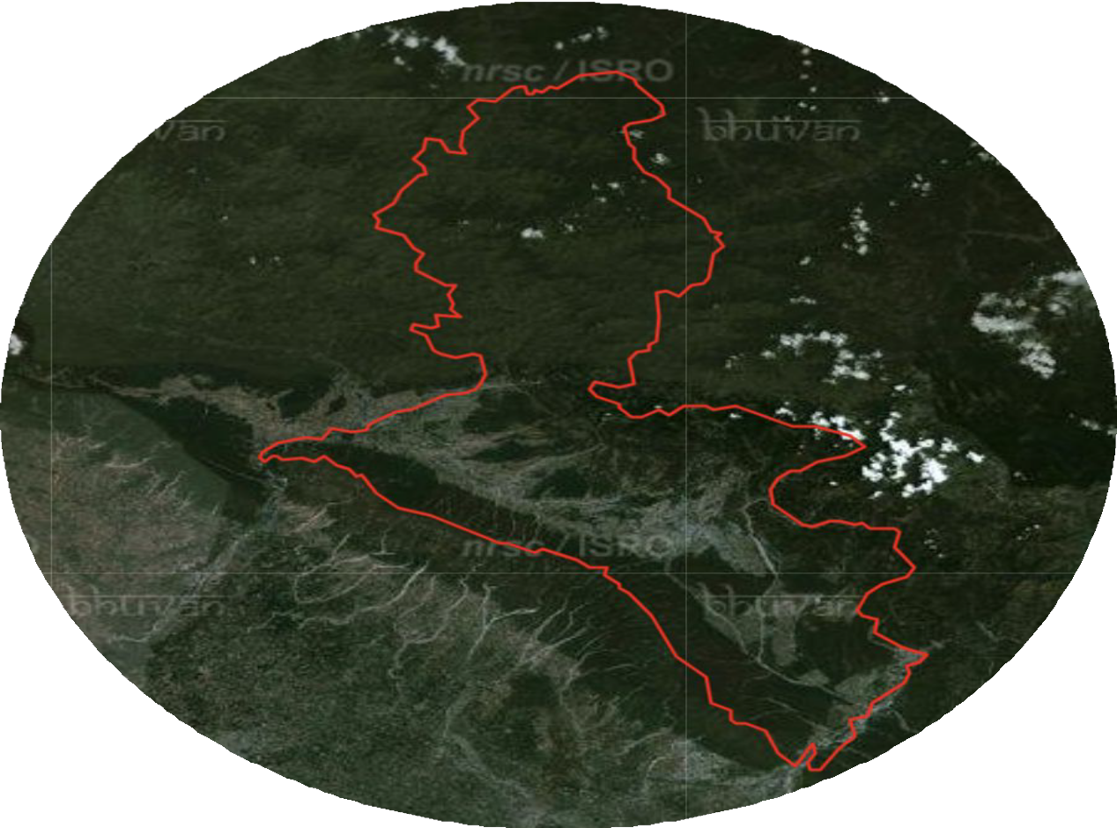
ACCESSING DEFORESTATION BY USING SATELLITE IMAGINARY IN DEHRADUN DISTRICT
Dehradun
UNDER THE SUPERVISION
MR. RAMESH KUMAR

Slide 2
INTRODUCTION
Deforestation is a critical environmental issue that significantly impacts biodiversity, climate change, and human livelihoods.
Accurate mapping and monitoring of deforestation are essential for effective forest management and conservation strategies.
This project aims to develop a comprehensive deforestation mapping approach focusing on Dehradun, a district in India known for its rich forest cover.
The primary objective is to analyze changes in forest cover over a five-year period, from 2015 to 2020, using remote sensing and advanced geospatial techniques.

Slide 3
LITERATURE REVIEW
Dr. Rashmi Saini et el. Crop Classification On Single Data Sentinel-2 Imagery
The study used Sentinel-2 satellite imagery and machine learning (Random Forest and SVM) to classify crops in Roorkee, Uttarakhand. Random Forest achieved higher accuracy (84.22%) than SVM (81.85%). High-Density Forest was classified best, while Fodder had lower accuracy due to spectral overlap. Sentinel-2 proved effective for vegetation mapping.
2. Dr. Rashmi Saini et el. Exploring capabilities of sentinel-2 for vegetation mapping using RF
This study aims to classify crop using single date Sentinel-2 imagery in the Roorkee, district Haridwar, Uttarakhand, India. Classification is performed by using two most popular and efficient machine learning algorithms: Random Forest (RF) and Support Vector Machine (SVM).

Slide 4
3. Battude M et el. “Estimating maize biomass and yield over large areas using high spatial and temporal resolution Sentinel-2A like remote sensing data. Remote Sens Environ.”
High-resolution remote sensing data, like that from Sentinel-2A, provides valuable insights into agricultural productivity. Battude et al. (2016) demonstrated the potential of Sentinel-2A-like data to estimate maize biomass and yield over large areas, emphasizing its high spatial and temporal resolution. Their work highlights the importance of advanced remote sensing technologies in agricultural monitoring, enabling accurate predictions critical for resource management and planning.

Slide 5
PROBLEM STATEMENT
This project, "Assessing Deforestation Using Satellite Imagery in Dehradun district" aims to leverage Sentinel-2 satellite images to analyze deforestation trends between the years 2015 and 2020.
By comparing forest cover across these years, the study seeks to quantify the extent of deforestation, identify affected regions, and provide a basis for understanding the drivers and impacts of forest loss.
The project's outcomes will contribute to better monitoring and management of forest resources, aiding in conservation and sustainable development efforts.

Slide 6
MOTIVATION
Deforestation poses a significant threat to ecosystems, biodiversity, and climate stability.
Traditional monitoring methods have limitations in coverage, frequency, and accuracy.
Integration of satellite imagery and deep learning offers a promising solution.
Satellite images provide real-time, high-resolution data for detecting changes in land cover.
Deep learning algorithms automate the analysis of large datasets, enhancing precision in deforestation mapping

Slide 7
OBJECTIVES
1. Deforestation Mapping
Analyze deforestation patterns in Dehradun for 2015 and 2020 using satellite imagery.
Develop detailed maps to visualize forest cover changes.
2. Comparative Analysis
Compare deforestation trends between 2015 and 2020 to identify changes and underlying causes.
Highlight the extent and impact of deforestation over time.

Slide 8
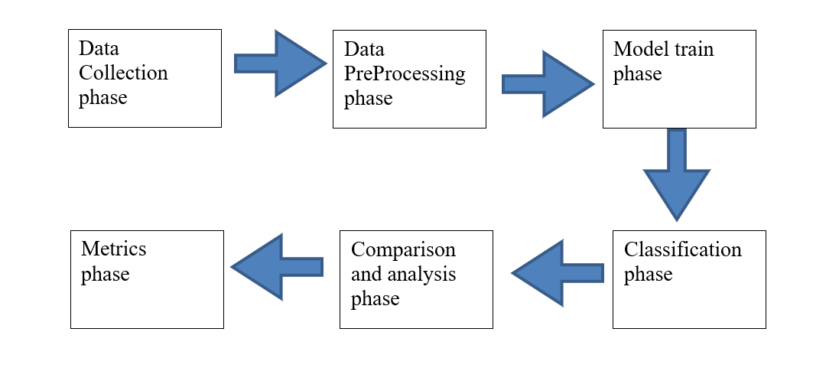
METHODOLOGY

Slide 9
PROGRESSION AND COMPARATIVE ANALYSIS OF DEFORESTATION DATA (2015 VS 2020)
Analysis of 2015 Data
Detailed deforestation analysis was conducted on 2015 data in the pervious semester.
Outcomes provided insights into key deforestation trends.
Analysis of 2020 Data
Currently applying the same methodology to 2020 data.
Ensures consistency in the approach for the accurate comparison.
3. Comparison of Outcomes
Results from 2015 and 2020 data will be cpmpared
Aim to identify patterns, trends, and changes in deforestation.
Insights will guide understanding of deforestation progression over time.

Slide 10
IMPLEMENTATION STEPS
The project will follow a systematic approach involving:
Data collection: through sentinel-2, Copernicus.
Preprocessing: through SNAP , atmospheric correction.
Composing band: merge band (2,3,4,8) through Arc GIS.
Mosaic: merge three tiles through Arc GIS.
Masking: extracting Dehradun shape through mosaic raster.
Creating training data.
Classification: K-means, ISO Clustering, Random forest, MLC (Most Likelihood Classification).
Comparison: Comparison between classified images of 2015 and 2020.

Slide 11
TECHNIQUES UTILIZED
Algorithm specific model training and optimization:
K-Mean: Train and optimize K-Means clustering algorithms to identify distinct cluster of deforested and non- deforested area.
Random forest: Develop a random forest classifier using labelled satellite image to accurately classify deforestation pattern.
ISO Clustering: Implement the ISO Clustering algorithm to automatically detect clusters in satellite data.
MLC: Utilize maximum likelihood classifier to model the probability distribution of deforested and non- deforested classes and perform classification based on these probabilities.

Slide 12
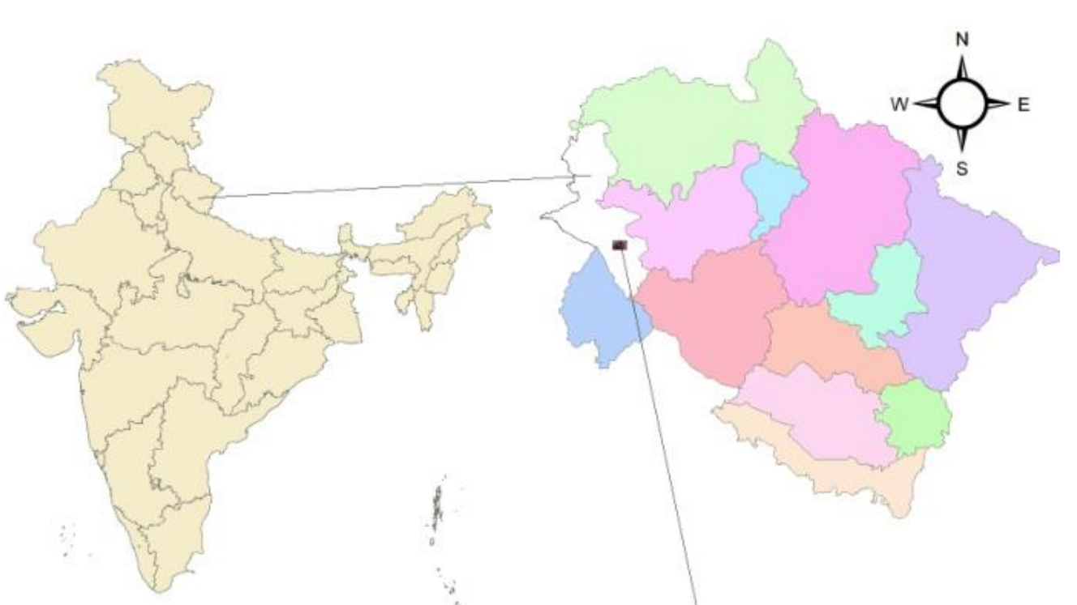
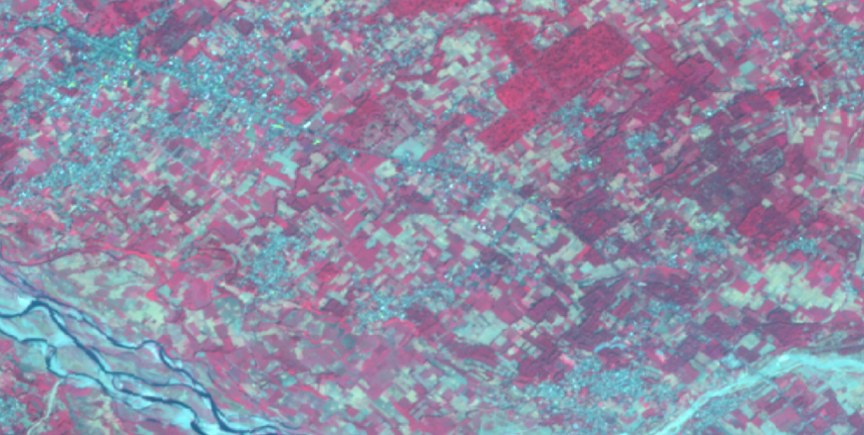
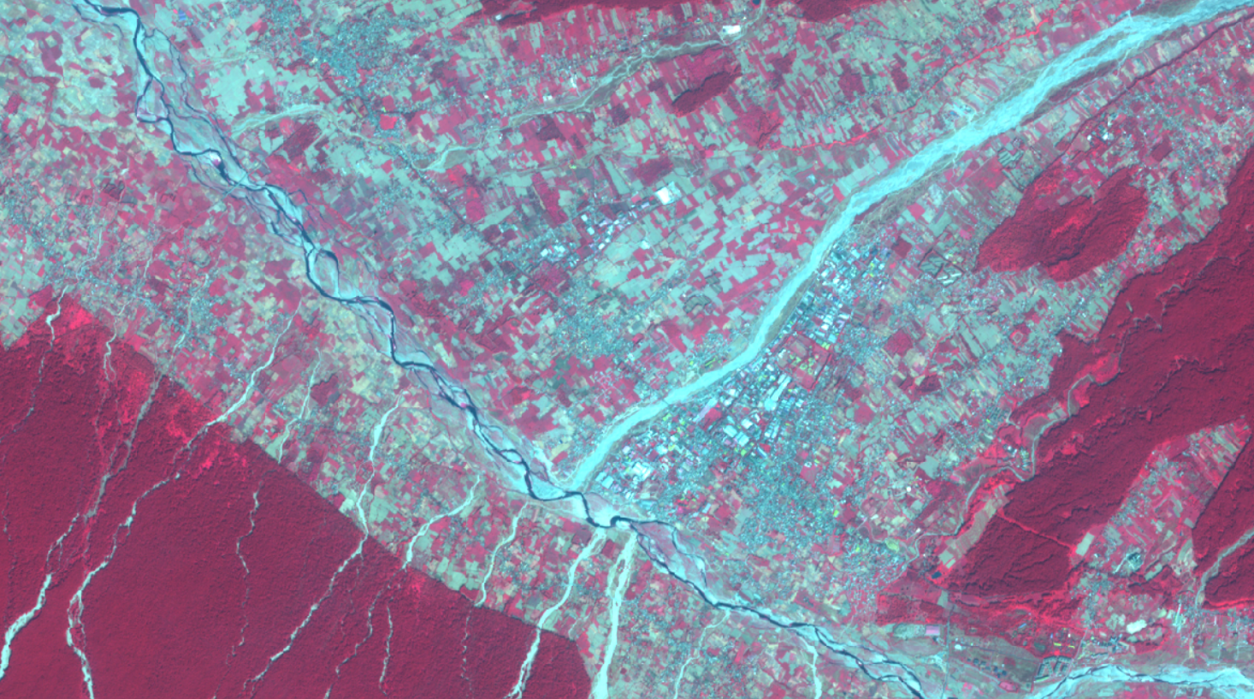
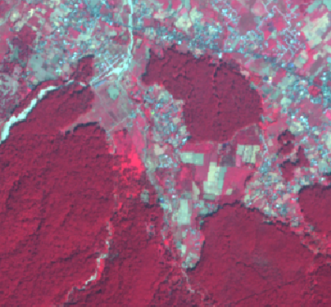
Processing of sentinel-2 data
Sentinel-2 image

Slide 13
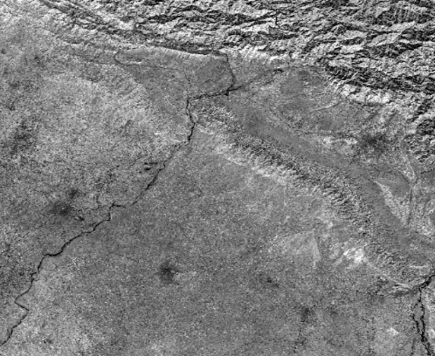
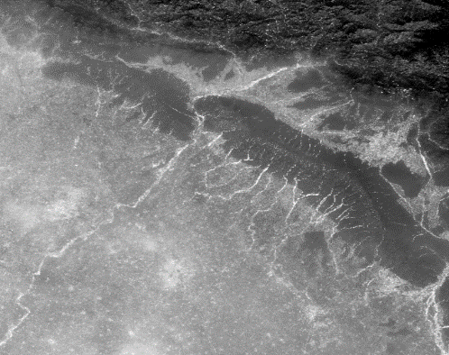
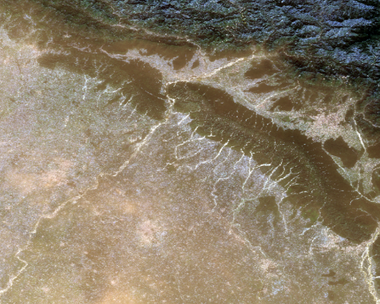
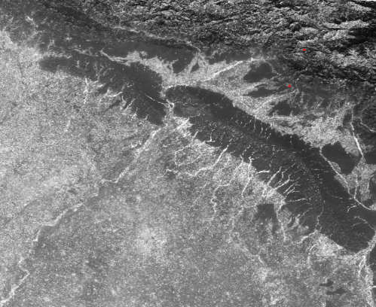
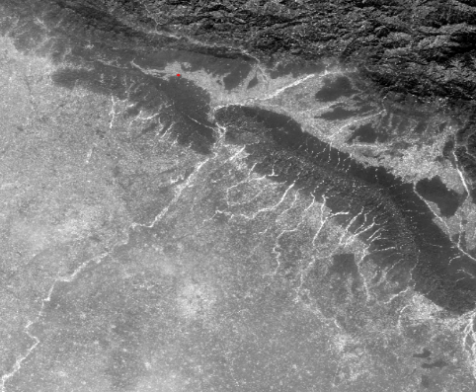
BAND 8
BAND 4
COMPOSITION
BAND 3
BAND 2

Slide 14
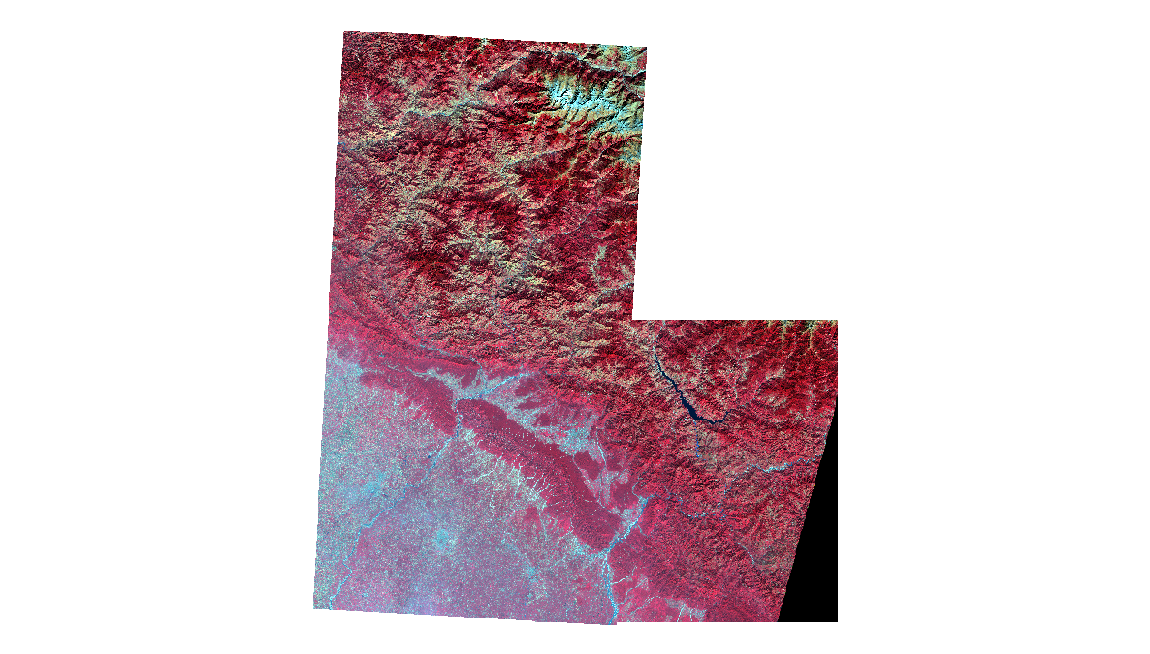
MOSAICKING

Slide 15
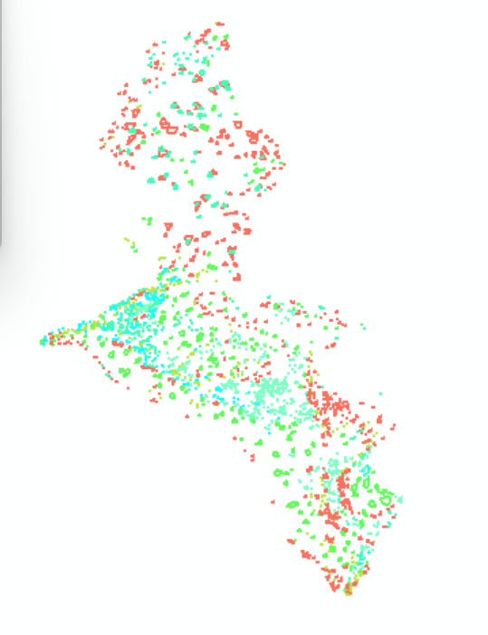
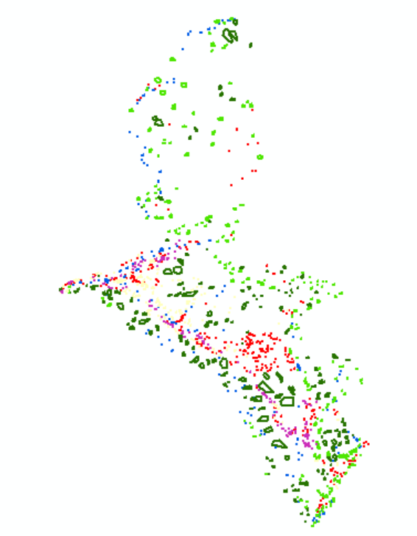
TRAINING SAMPE LABEL
2015
2020

Slide 16
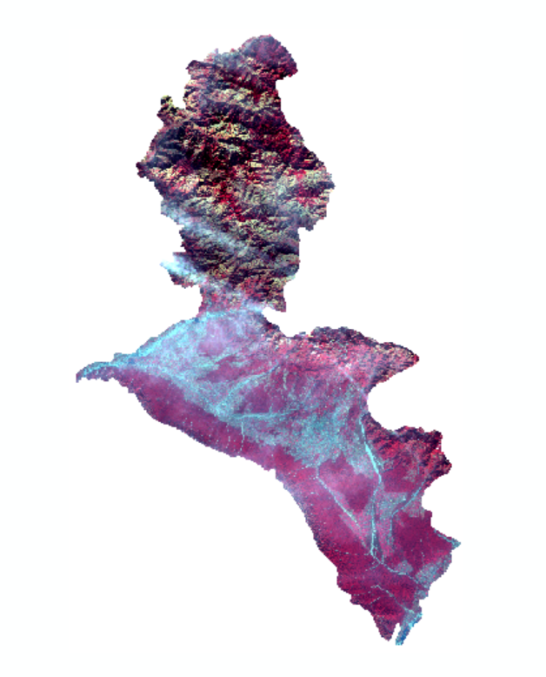
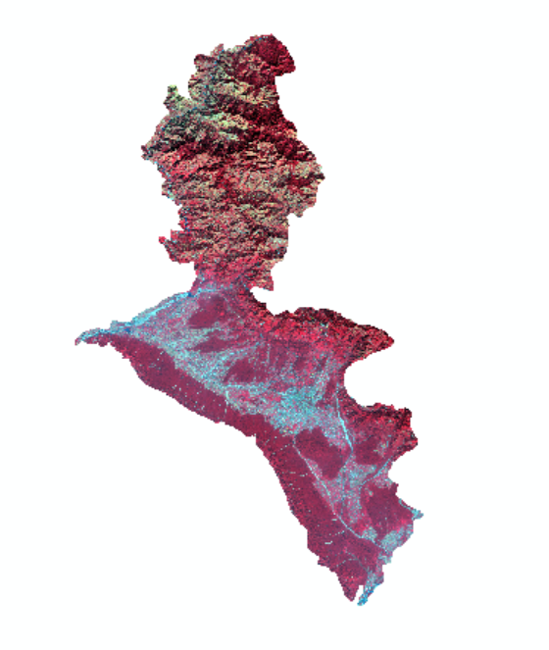
MASKING COMPARISON
2015
2020
Raster images of both year

Slide 17
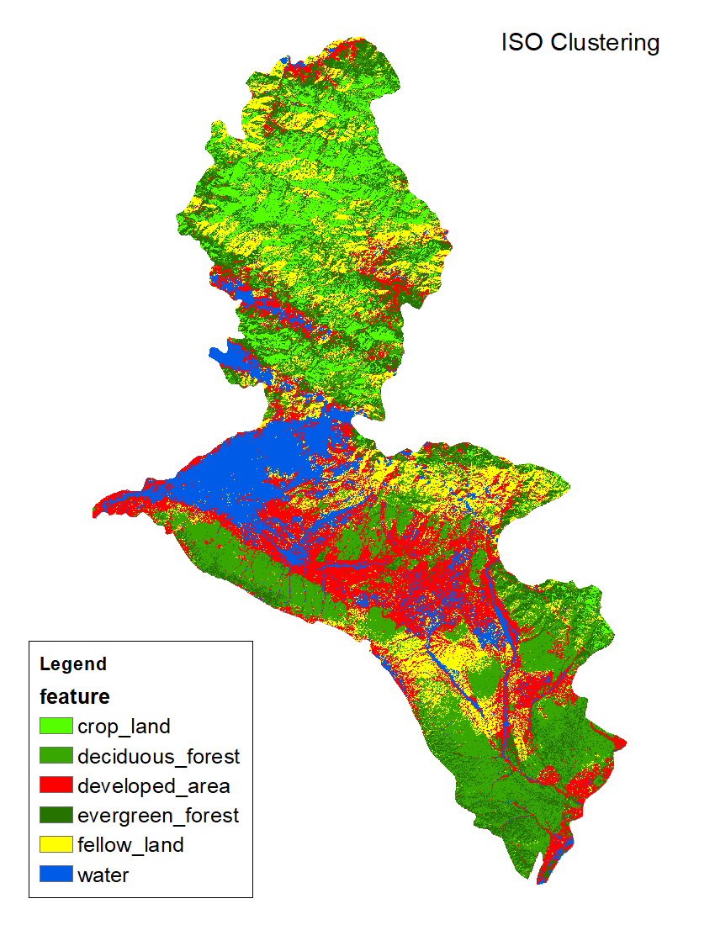
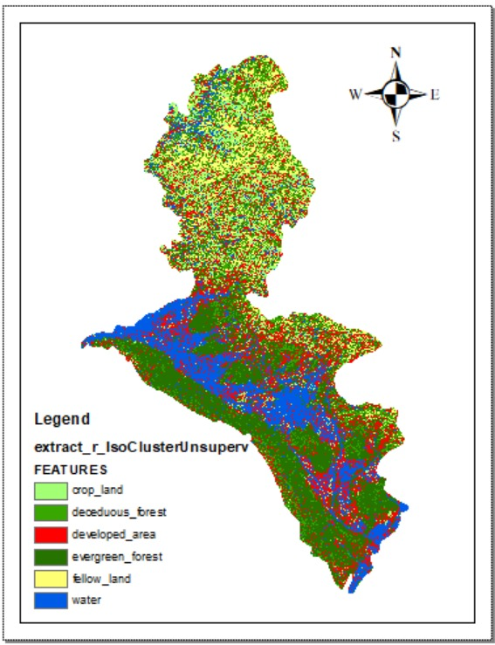
2015
ISO CLUSTERING classification image
2020

Slide 18
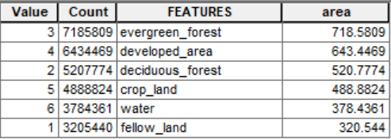
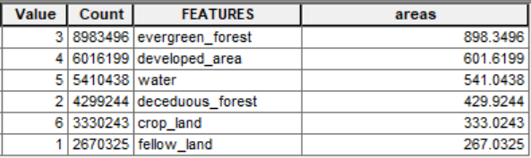
COMPARATIVE ANALYSIS OF DEFORESTATION: 2015 vs 2020
ISO CLUSTERING
2015
2020
ISO CLUSTERING classification raster pixel calculate area

Slide 19
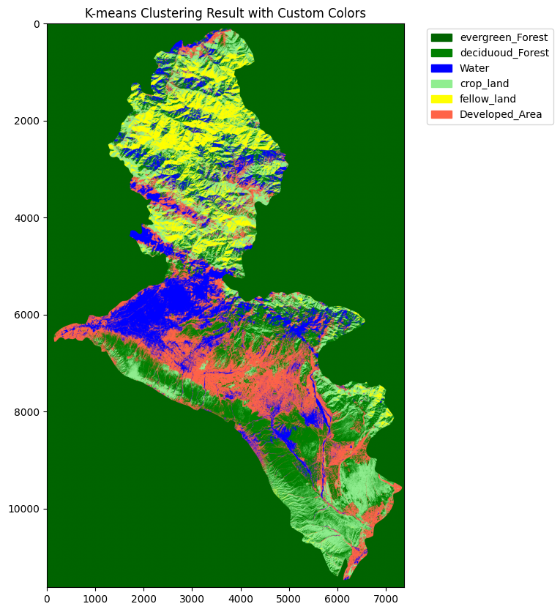
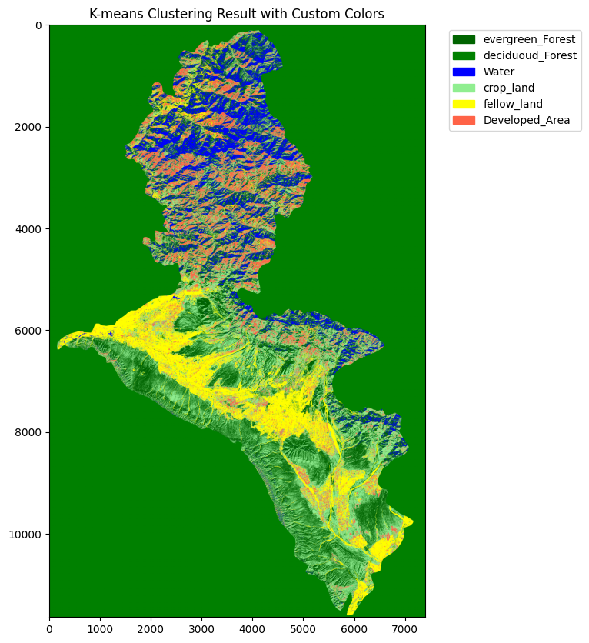
K MEANS Classification
2020
2015
Iso Clustering

Slide 20
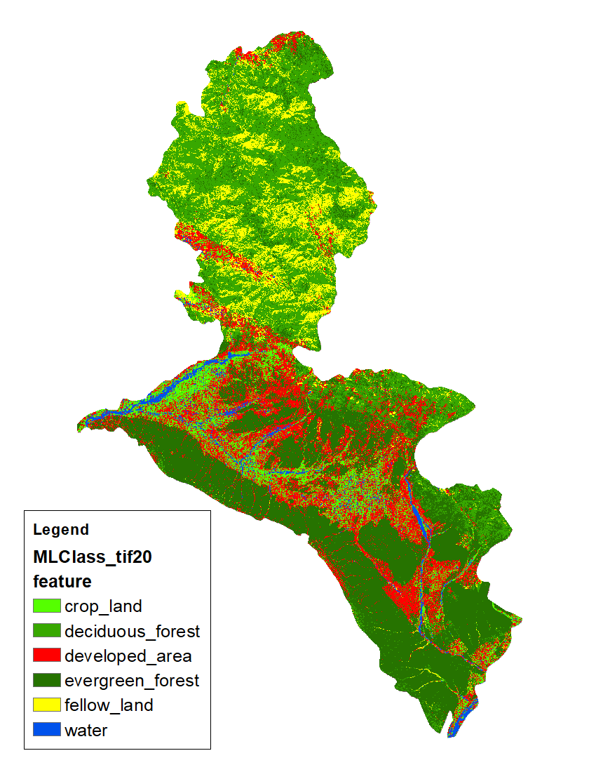
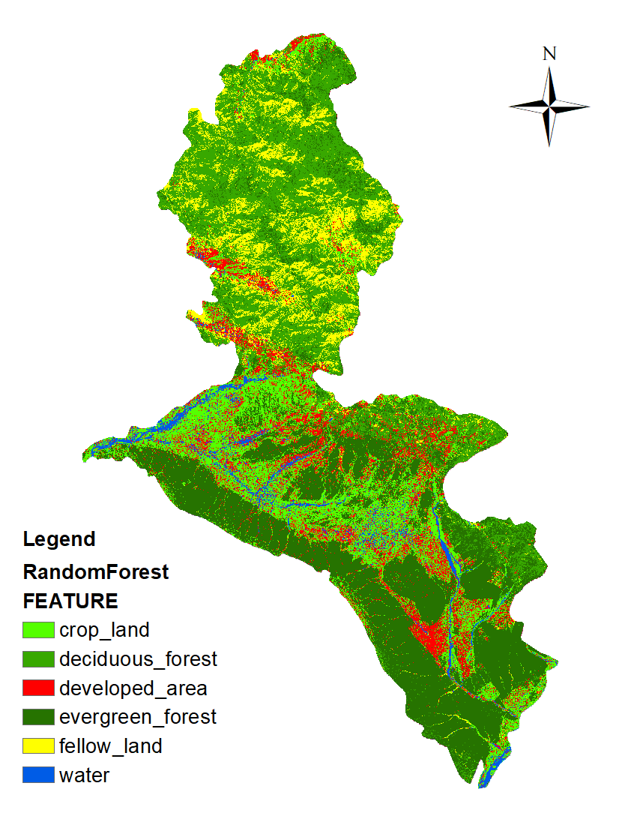
2015 Classified raster image
MLC
Random Forest

Slide 21
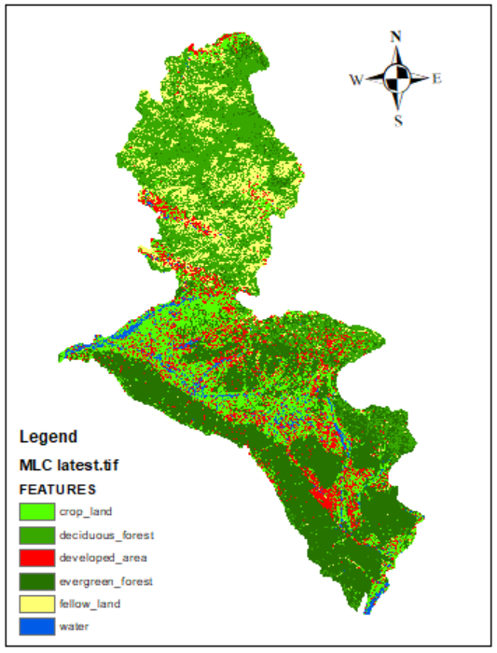

2020 Classified raster image
MLC
Random Forest
MLC
Random Forest

Slide 22
COMPARATIVE ANALYSIS OF DEFORESTATION: 2015 vs 2020
Raster image area based on grid
RFC 2015
RFC 2020
VALUE | COUNT | FEATURES | AREA(KM2)
1 | 3167517 | Developed area | 316.7517
811 | 837678 | Water | 83.7678
813 | 9944728 | Evergreen forest | 994.4728
999 | 8333151 | Deciduous forest | 833.3151
1357 | 3223640 | Fellow land | 322.3640
1949 | 5199963 | Crop land | 519.9963
VALUE | COUNT | FEATURES | AREA(KM2)
1 | 3090412 | Developed area | 309.0412
811 | 849483 | Water | 84.9483
813 | 9928238 | Evergreen forest | 992.8238
999 | 8311467 | Deciduous forest | 831.1467
1357 | 3028955 | Fellow land | 302.8955
1949 | 5498122 | Crop land | 549.8122

Slide 23
COMPARATIVE ANALYSIS OF DEFORESTATION: 2015 vs 2020
Raster image area based on grid
MLC
2015
MLC
2020
VALUE | COUNT | FEATURES | AREA(KM2)
1 | 3177239 | Developed area | 317.7239
811 | 837678 | Water | 83.7678
813 | 9783970 | Evergreen forest | 978.3970
999 | 8424283 | Deciduous forest | 842.4283
1357 | 3222916 | Fellow land | 322.2916
1949 | 5260591 | Crop land | 526.0591
VALUE | COUNT | FEATURES | AREA(KM2)
1 | 3177903.0 | Developed area | 317.7903
811 | 837678.0 | Water | 30.7678
813 | 9764908.0 | Evergreen forest | 976.4908
999 | 8437236.0 | Deciduous forest | 843.7236
1357 | 3222817.0 | Fellow land | 322.2817
1949 | 5266135.0 | Crop land | 526.6135

Slide 24
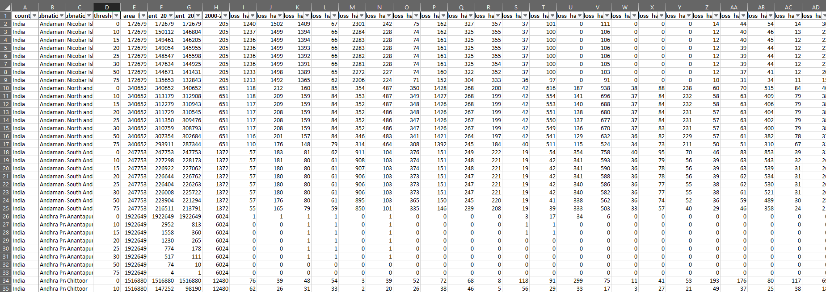
GLOBAL FOREST RESEARCH
THESE DATASET TAKES AS A GROUND TRUTH FOR OUR RESULT COMPARISON AND CALCULATE THE ACCURACY
ACCORDING TO GLOBAL FOREST RESEARCH THE DEFORESTATION FROM 2015 TO 2020 IS 222 HECTARES

Slide 25
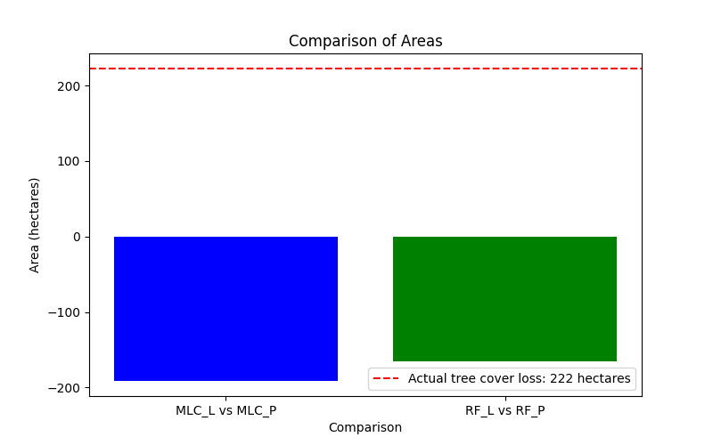
RESULT

Slide 26
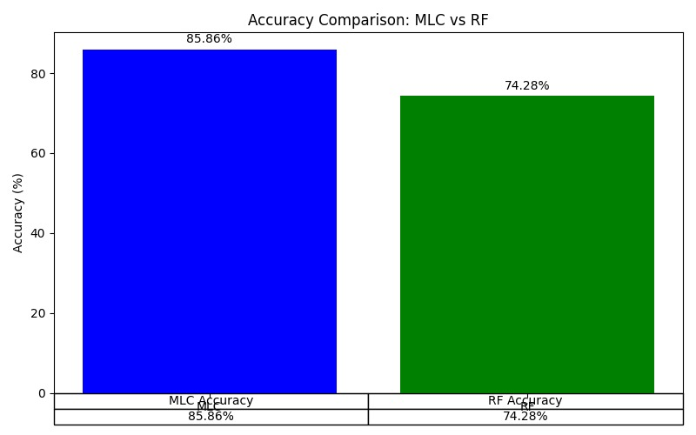
RESULT

Slide 27
OUTCOMES
Utilize advanced satellite imagery and deep learning algorithms.
Generate highly detailed maps of deforestation patterns and hotspots.
Identify priority areas for conservation and intervention.
Contribute to understanding drivers and dynamics of deforestation.
Serve as valuable resources for policymakers, researchers, and communities.
The results highlight the difference in deforestation patterns between 2015 and 2020.
This comparison helps identify trends,underlying causes,and the overall impact of deforestation during the studied period.

